Slide 1
ACCESSIBILITY IN THE REAL WORLD
ORB University
*ACCURACY IN DETAILS, AND ACCESSIBILITY WALKS
Understanding their purpose
ORB UNIVERSITY – OCTOBER 25, 2023
PRESENTED BY Theodore Cannon

Slide 2
THE PURPOSE OF THIS PRESENTATION
To give a generalized overview of the importance of accessibility.
To better understand an aspect of our job that you may not be familiar with.
To become more informed about the impact of our design decisions during construction and in the real world.

Slide 3
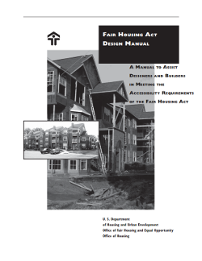
BACKGROUND: ACCESSIBILITY STANDARDS COME FROM…?
Four (4) main sources for accessibility standards that influence how we design and inspect our projects.
Fair Housing Act Design Manual (FHA)
Building code (IBC, referencing ANSI A117.1)
Americans with Disabilities Act Standards for Accessible Design (ADA)
4. *Terry Kitay of Baker Donelson (Tolerances)

Slide 4
*FOR MORE ACCESSIBILITY INFORMATION
“ Theresa L. "Terry" Kitay focuses her practice on defense and preventive representation of clients in the housing industry in all civil rights matters.”
- Baker Donelson Website.
Terry Kitay “Housing Accessibility” presentation is located on the server in the ORB Resource Library > Accessibility Items

Slide 5
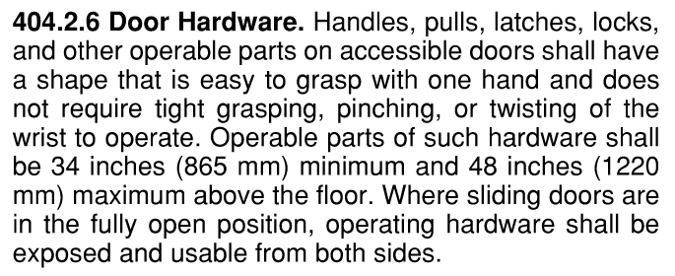
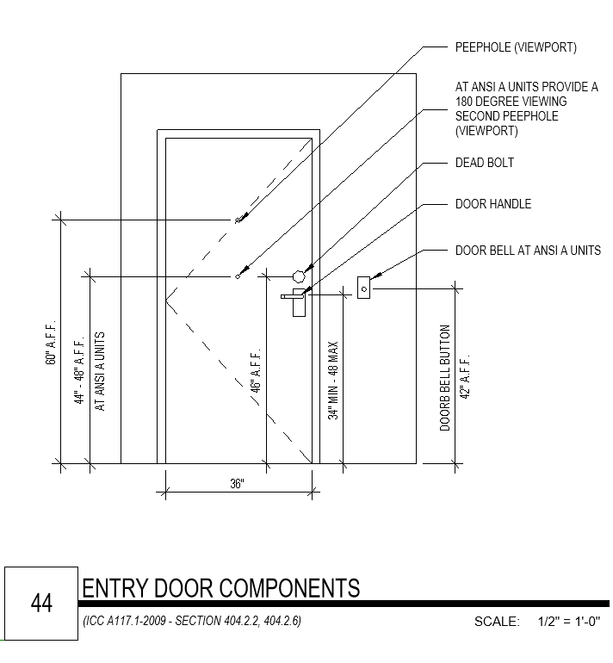
FROM CODE TO DETAIL
Let’s take a closer look…
1
Most constraints are derived from the code…
2
Then comes the drawings.

Slide 6
THE IMPORTANCE OF ACCURACY WITH THE DRAWINGS

Slide 7
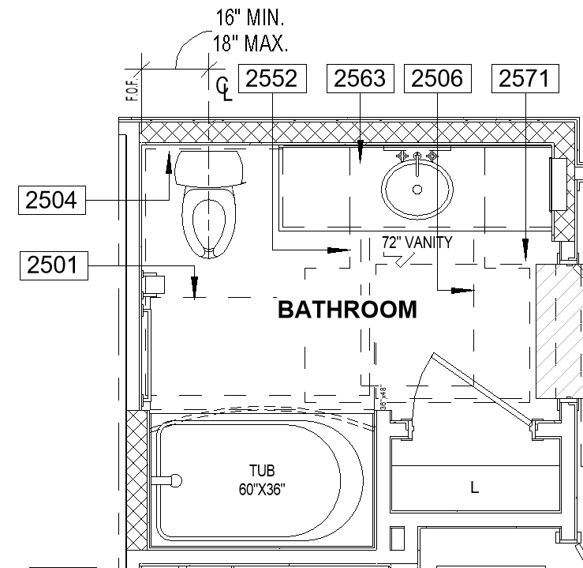
THE IMPORTANCE OF THE DRAWINGS
There are multiple points within our drawings where it is important to understand our accessibility standards and correctly implement them within our designs. For example: A bathroom….
THE TYPE OF BATHROOM DETERMINES EVERYTHING
Toilet
Clear floor space
Distance from the finished wall
Distance from vanity
Bathroom Vanity
Removable base cabinet?
Bathtub/Shower
Tub or Shower?
Clear floor space
Closet
Depth

Slide 8
THE IMPORTANCE OF THE DRAWINGS
Even areas of design that may seem minor have multiple points where it is important to understand our accessibility standards and correctly implement them. For example: Doors….
Doors
Approach side?
Push or Pull?
Closer and/or latch provided?

Slide 9
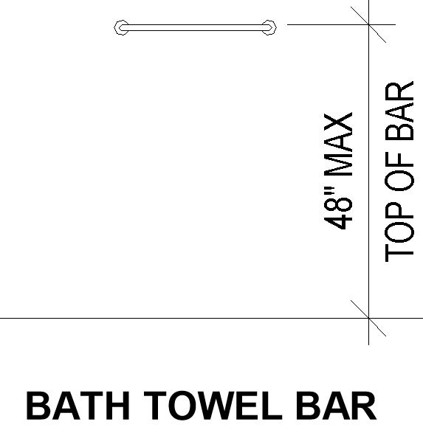
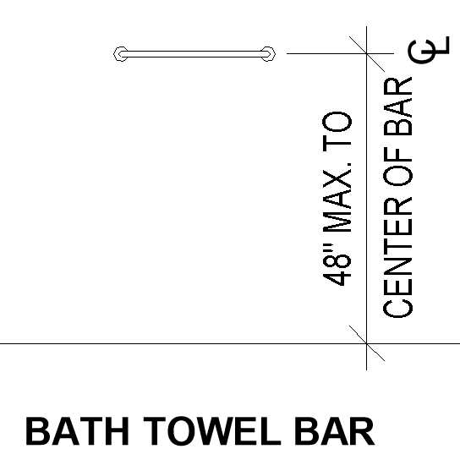
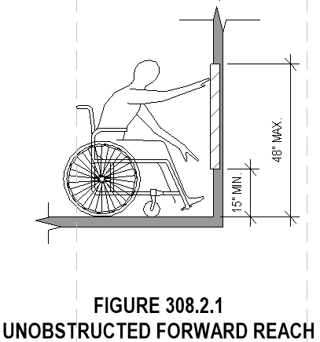
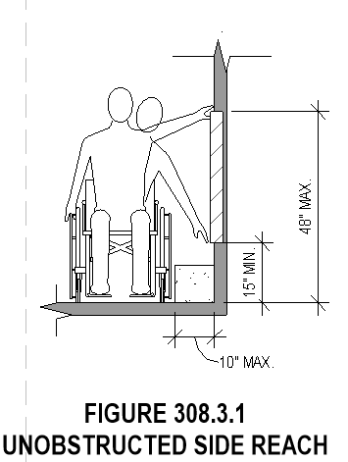
THE IMPORTANCE OF THE DRAWINGS
We must ensure accuracy when it comes to our drawings, otherwise, certain items may not comply.
Which detail is correct?
REACH RANGES
A
B
Errors such as the one highlighted in Detail B can lead to extra work in the field which equates to more money.

Slide 10
FROM CODE TO DETAIL TO BUILD
1
2
2
3

Slide 11
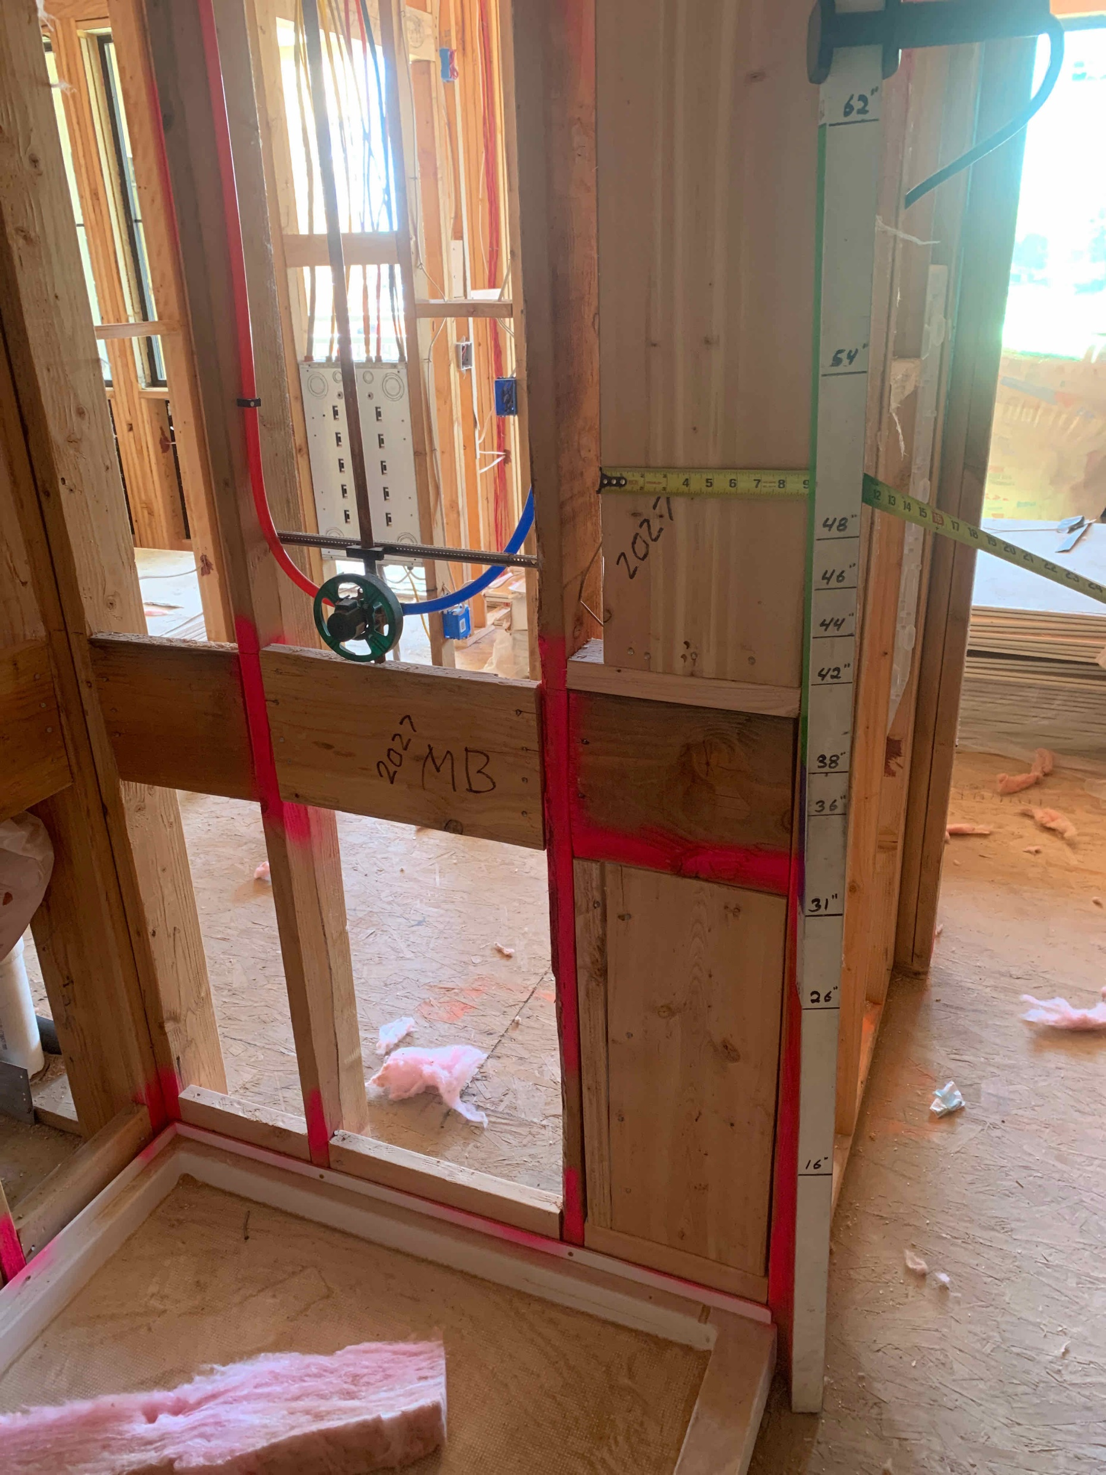
WHAT’S AN ACCESSIBILITY INSPECTION…?
Accessibility inspections are an additional service provided to the client by ORB. It is something a client can choose to add to their contract.
The purpose of these inspections is to ensure that the client/contractor is truly following our drawings.
This service has not always been offered by ORB. It began after discovering the consistent rate at which accessibility items were not being implemented during construction.
This can lead to problems down the line that include unsatisfied renters, and lawsuits.

Slide 12
WHAT’S AN ACCESSIBILITY INSPECTION…?
What is it we actually do…?
The purpose of these inspections is to ensure that the client/contractor follows our drawings.
We coordinate with the construction team on all accessibility items during rough framing and finish construction.
This includes:
Fielding questions regarding accessibility across the entire site.
Coordinating the scheduling of accessibility inspections.
Inspecting every applicable area of the site during accessibility inspections.
Often reinspecting areas that were missed or not completed on the first inspection.
Performing post-walk procedures

Slide 13
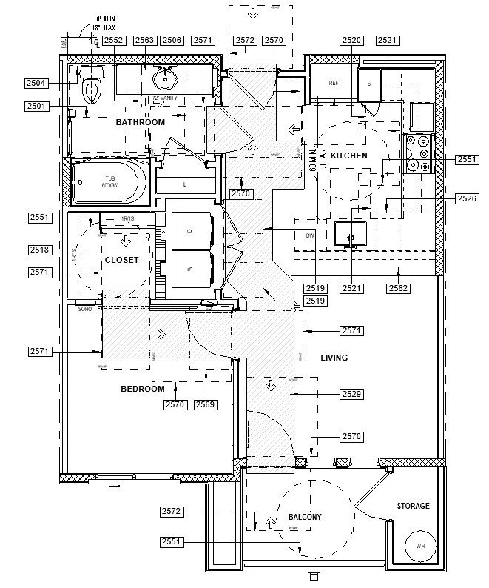
WHAT’S AN ACCESSIBILITY INSPECTION…?
There are multiple types of accessibility Inspections that ORB performs for a project.
Today’s Focus
For Units
Unit Rough Framing Inspections
Unit Finish Inspections
For Common Areas
Common Area Rough Inspections
Common Area Finish Inspections
For Site
Site Accessibility Inspections

Slide 14
HOW OUR DRAWINGS TRANSITION TO THE REAL WORLD.

Slide 15
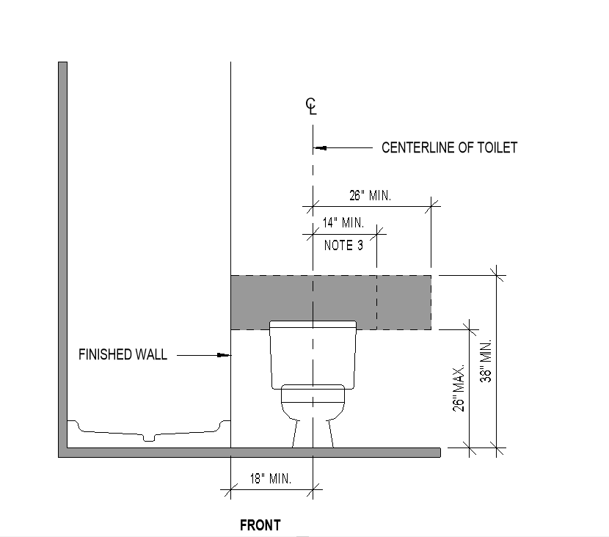
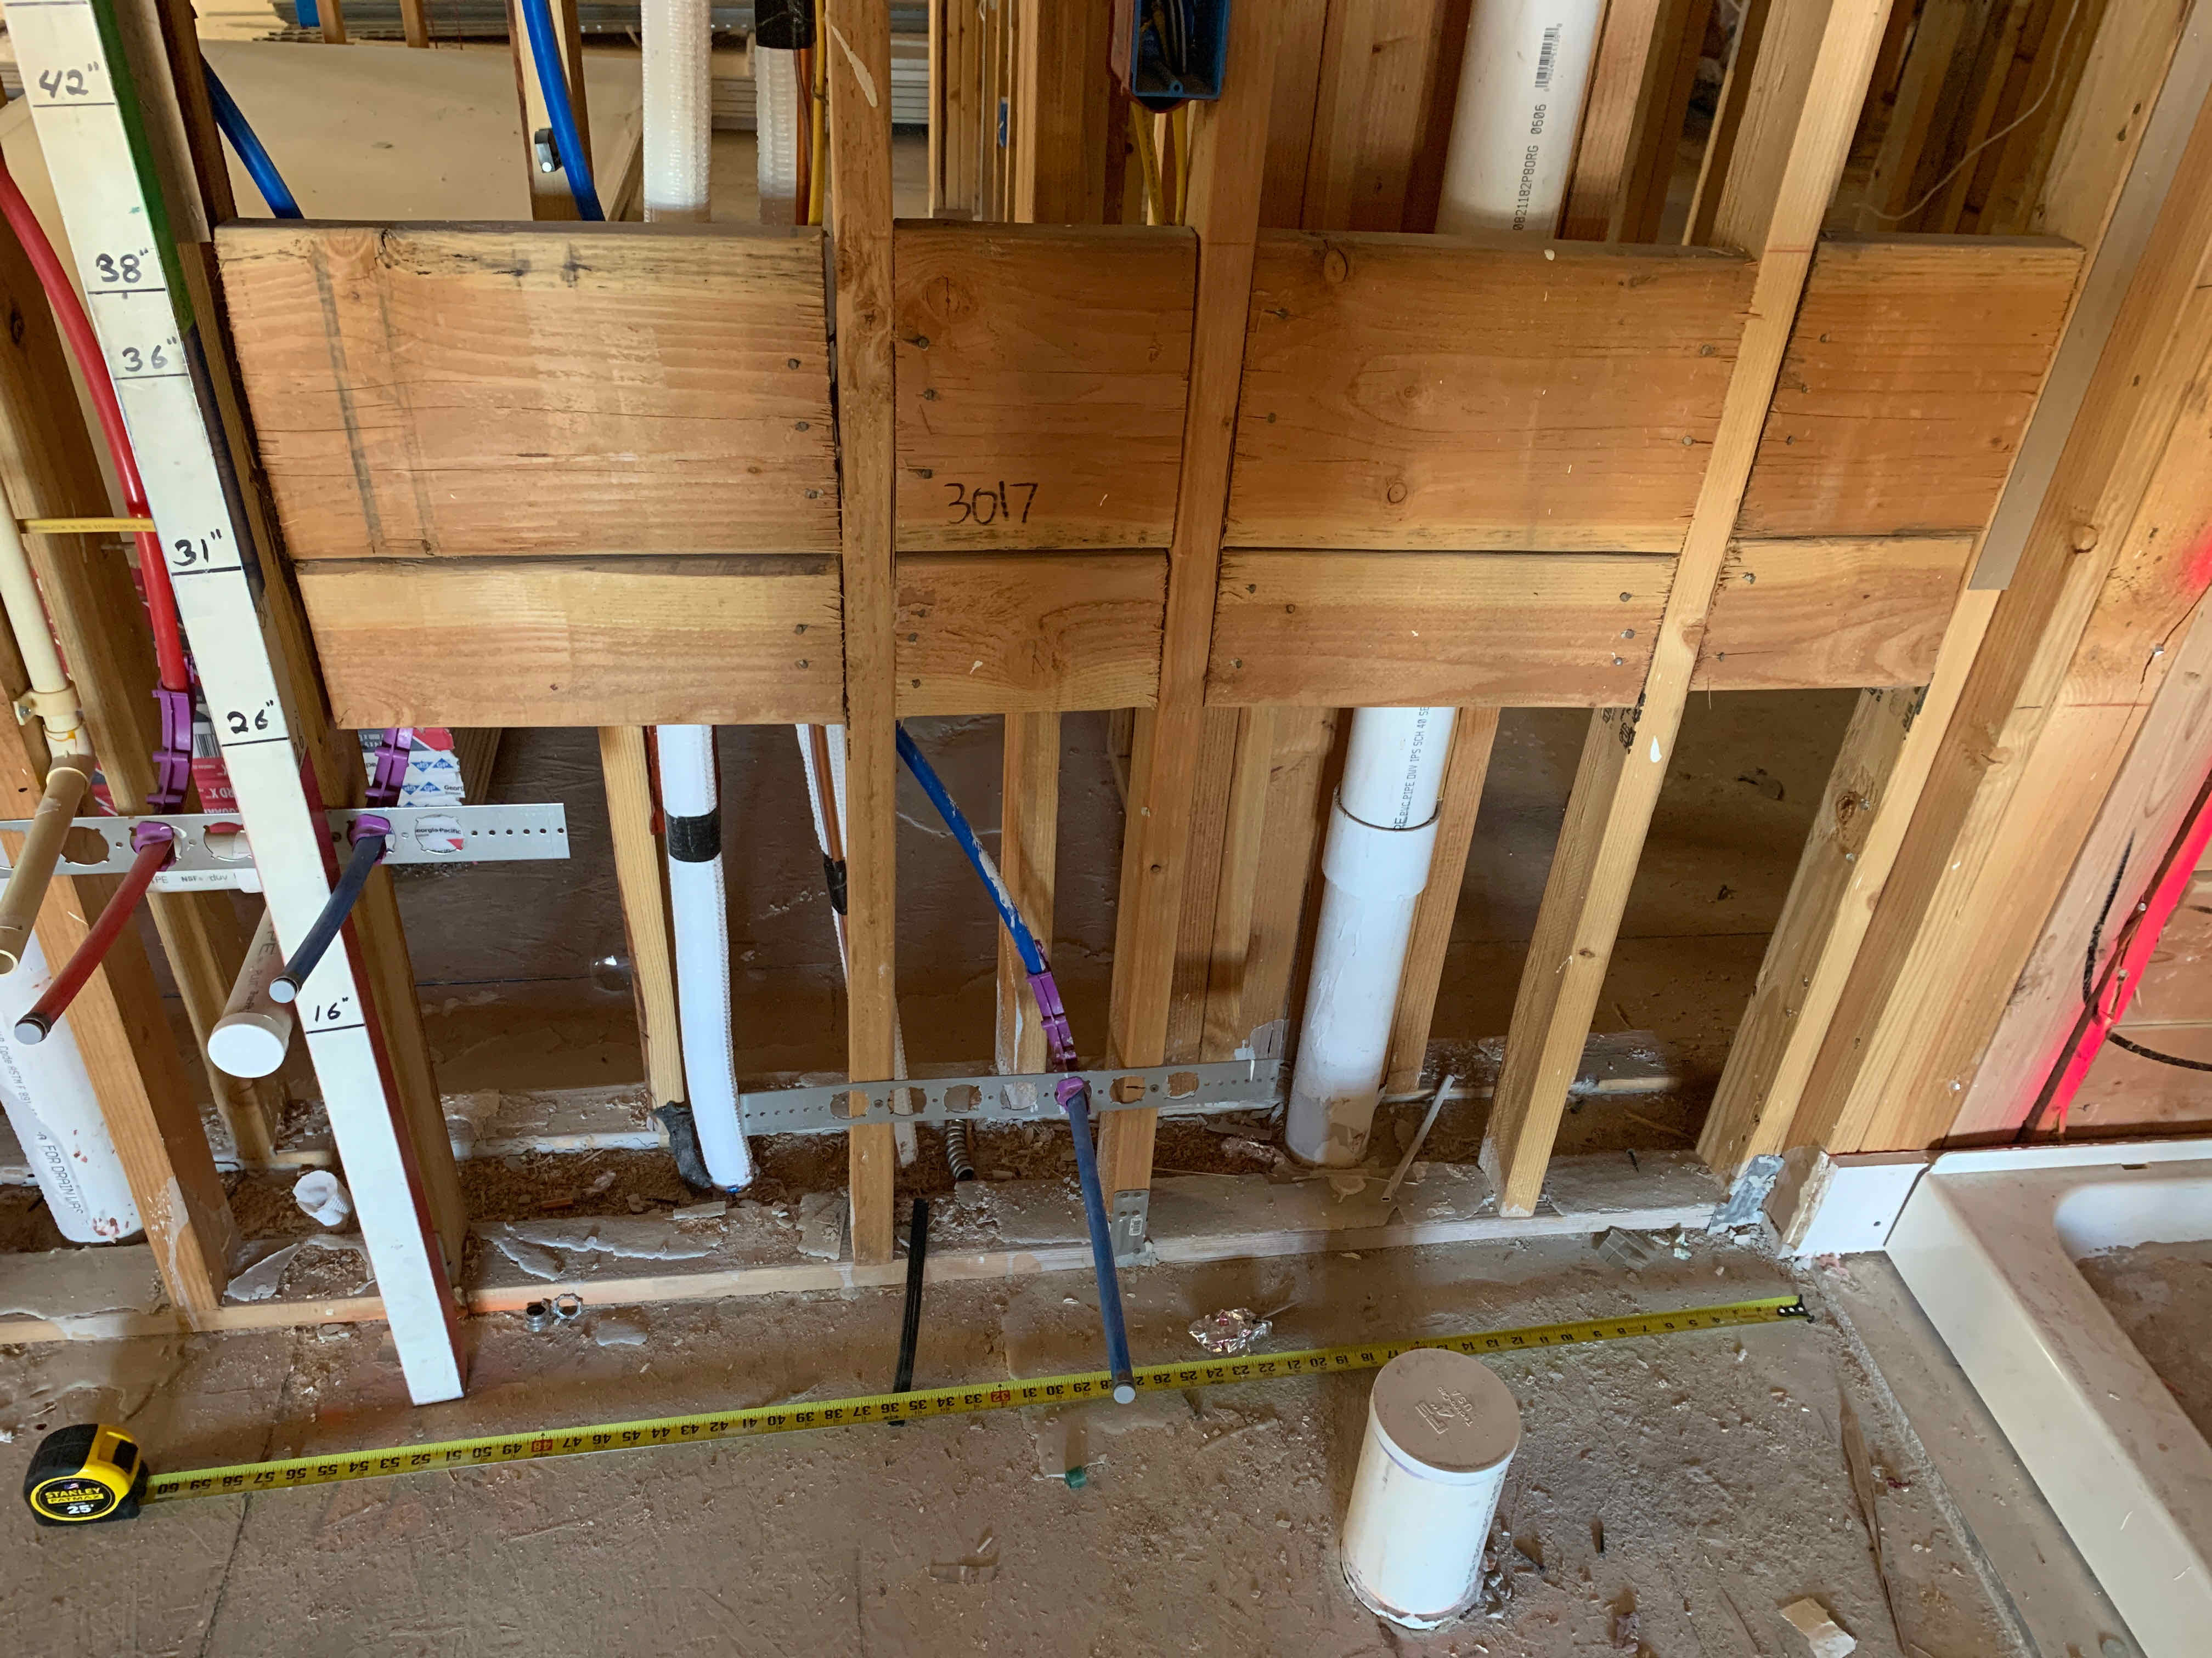
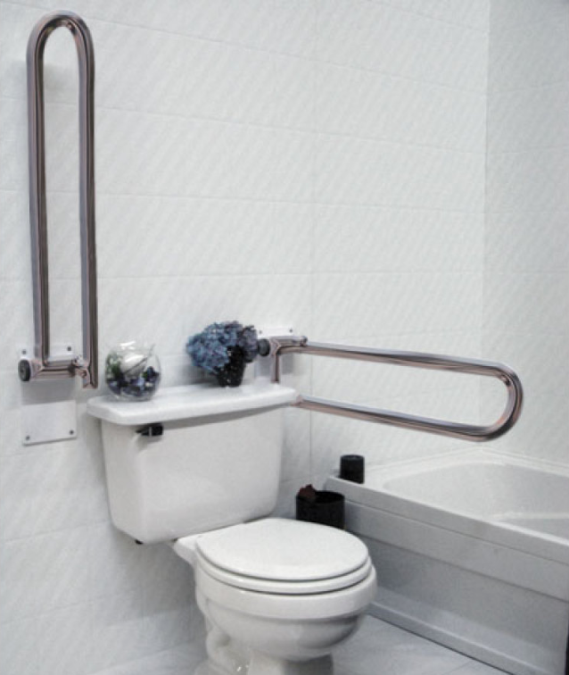
IT ALL COMES FROM OUR DETAILS
Why dimensions are important…
ORB DETAIL 38/A7.8.12
ROUGH FRAMING
FINISH - SWING UP GRAB BAR
18” MIN. FOR TOILET AT NO CORNER CONDITION. WHY IS THIS DIMENSION 18” MIN. AND NOT 16”-18”?
ANSI B – REINFORCEMENT FOR TOILETS AT NO CORNER CONDITION

Slide 16
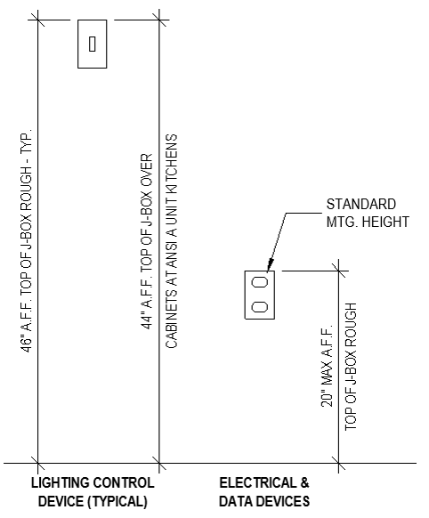
IT ALL COMES FROM OUR DETAILS
Why understanding our details is important
ORB DETAIL 10/A7.8.12
ROUGH FRAMING
REACH RANGES
*NOTE THE REAL-WORLD IMPACT ACCESSIBLE MINIMUMS AND MAXIMUMS CAN HAVE ON THE USER EXPERIENCE.
TYPICAL J-BOX MOUNTING HEIGHTS

Slide 17
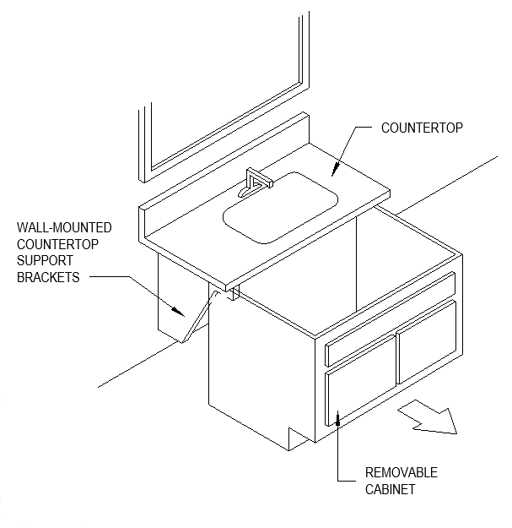
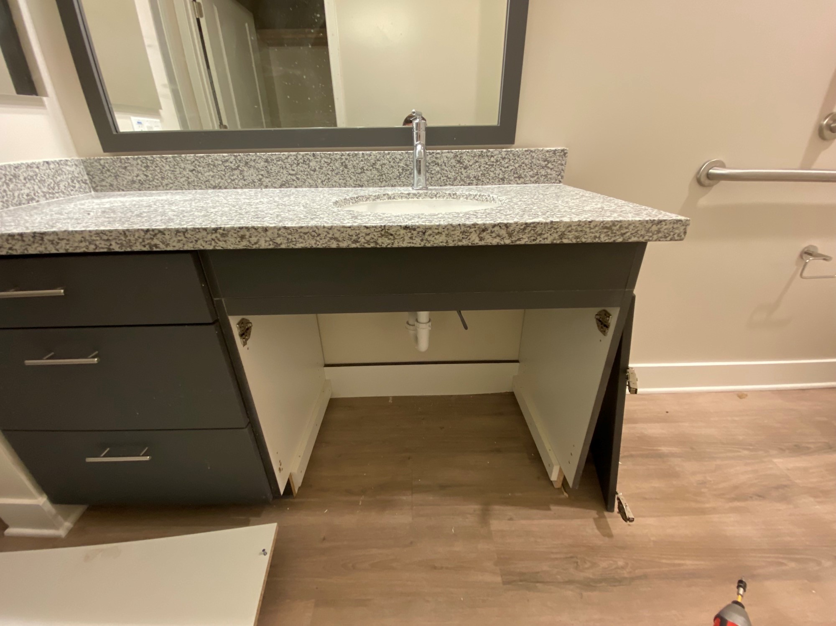
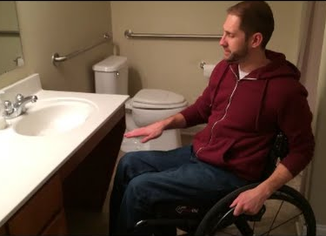
IT ALL COMES FROM OUR DETAILS
What it means to specify a detail…
ORB DETAIL 45/A7.8.12
ROUGH FRAMING
REAL WORLD
NOTE THE IMPORTANCE OF SOMETHING AS SIMPLE AS REMEMBERING TO SPECIFY TO CONTINUE THE FINISH FLOORING UNDER THE REMOVABLE CABINET.
THIS DIRECTLY IMPACTS THE USER EXPERIENCE
REMOVABLE BASE CABINETS

Slide 18
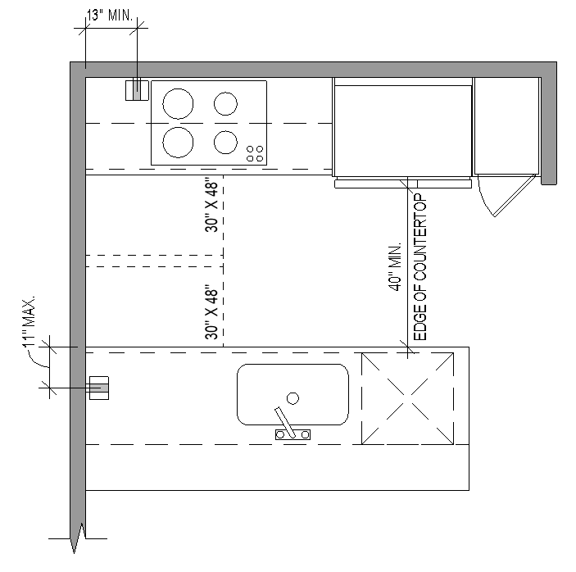
IT ALL COMES FROM OUR DETAILS
For units
ORB DETAIL 39/A7.8.12
GALLEY KITCHEN CLEARANCE
More info on this later.
POWER OUTLET LOCATIONS AND CLEARANCES AT GALLEY KITCHENS

Slide 19
FROM CODE TO DETAIL TO BUILD TO CHECKLIST
1
2
2
3
4
PROCORE INSPECTION CHECKLIST

Slide 20
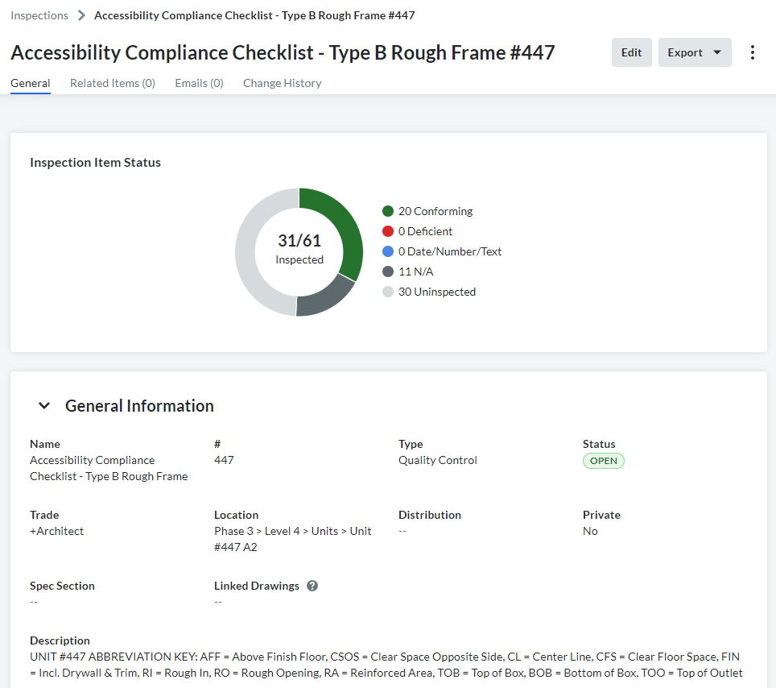
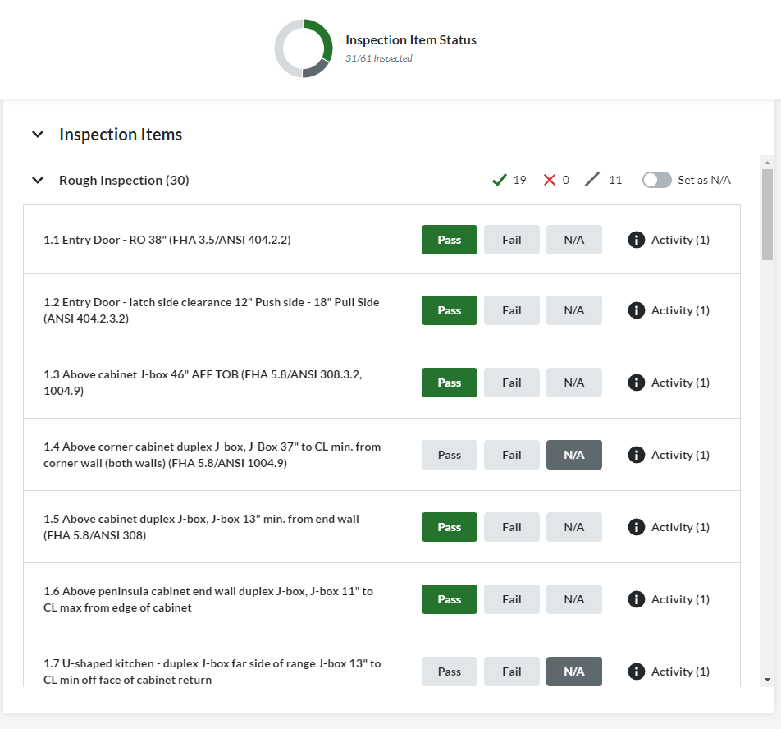
PROCORE INSPECTION CHECKLISTS

Slide 21
ACCESSIBILITY DETAILS IN THE REAL WORLD - DEMONSTRATION

Slide 22
LET’S SEE ACCESSIBILITY DETAILS IN THE REAL WORLD.
STATION 1 - J BOX HEIGHTS
Identify if the J BOX heights pass or fail the inspection
STATION 2 - MOCK TOILET and GRAB BAR BLOCKING
Identify if the blocking location/dimensions pass or fail the inspection
STATION 3 - GALLEY KITCHEN CLEARANCES
Identify if the galley kitchen meets the required clear space between the two opposing sides

Slide 23
*NOTE !
LET IT BE KNOWN THAT A PERMIT FROM THE CITY DOES NOT EXCUSE YOU FROM LAWSUITS IN THE FUTURE.

Slide 24
THE NEGATIVE POSSIBILITIES

Slide 25
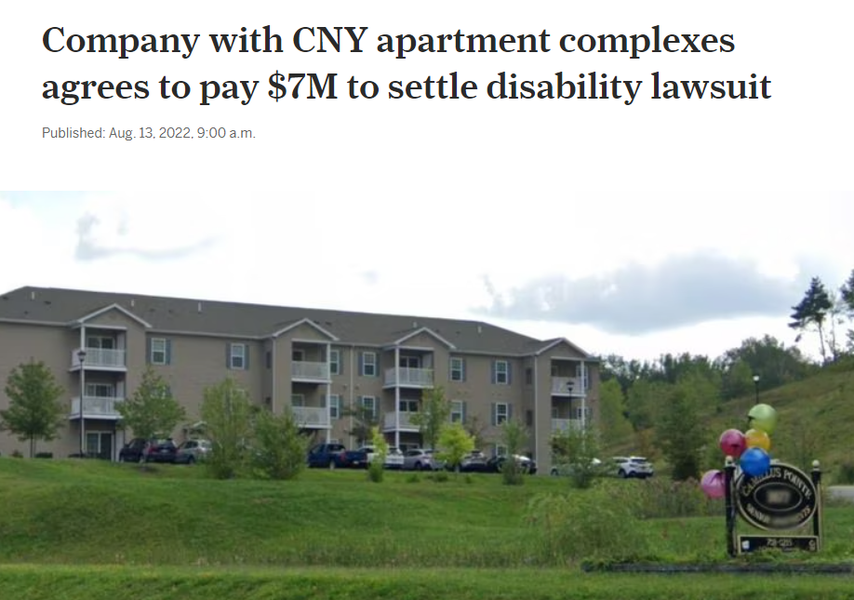
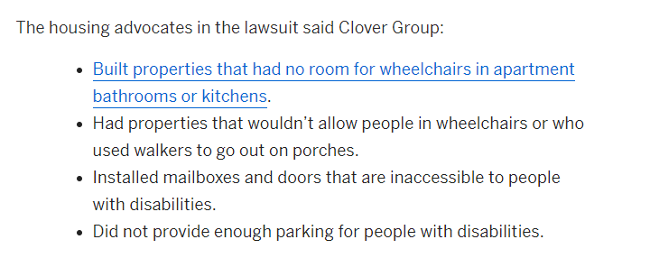
REAL WORLD IMPACT
Syracuse, NY

Slide 26
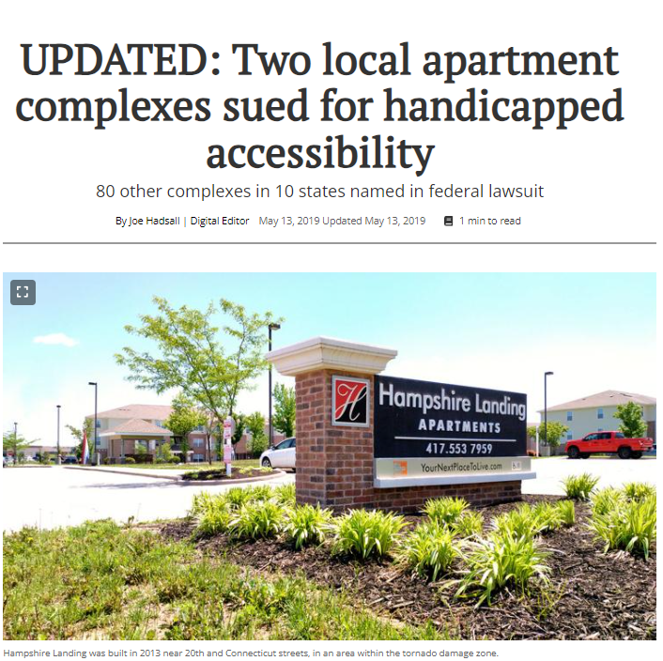
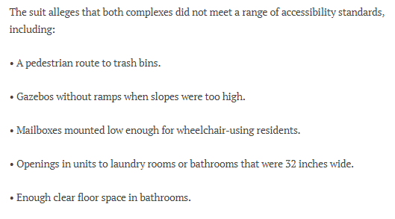
REAL WORLD IMPACT
Galena, KS

